Slide 1

How to test and debug a PHP application

Slide 2
Objectives
Distinguish between testing and debugging.
Distinguish between syntax, runtime and logic errors.
How do you debug a PHP application without special tools?
Are there PHP commands which help debugging?

Slide 3
Goals
The goal of testing
To find all errors before the application is put into production.
The goal of debugging
To fix all errors before the application is put into production.

Slide 4
Three Test Phases
Check the user interface to make sure that it works correctly.
Test the application with valid input data to make sure the results are correct.
Test the application with invalid data or unexpected user actions. Try to make the application fail.

Slide 5
Three Types of Errors
Syntax errors
Easiest to find
IDE helps detect
Runtime errors
Appear when running the application
Don’t violate syntax rules but cause interpreter errors.
Logic errors
Hardest to detect

Slide 6
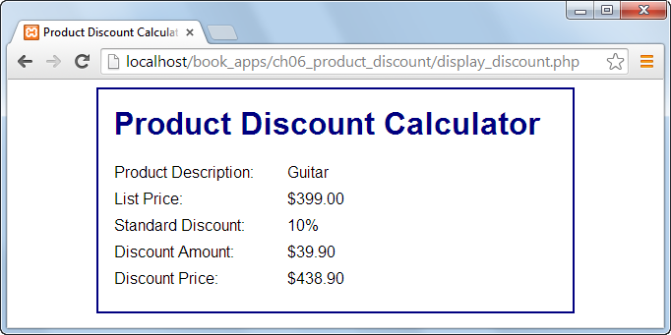
See the logic error?

Slide 7
First Steps
Make sure you are running and testing the right page.
Make sure you are editing the same page you are testing and updating.
Make sure you have saved your latest changes and uploaded them to the server.

Slide 8
Common Syntax Errors
Misspelling keywords.
Forgetting an opening or closing parenthesis, bracket, brace, or comment character.
Forgetting to end a PHP statement with a semicolon.
Forgetting an opening or closing quotation mark.
Not using the same opening and closing quotation mark.

Slide 9
Variable Name Errors
Misspelling or incorrectly capitalizing a variable name.
Using the wrong variable name. Ex. you created a variable called $email but you are using $Email.
Using a keyword as a variable name.

Slide 10
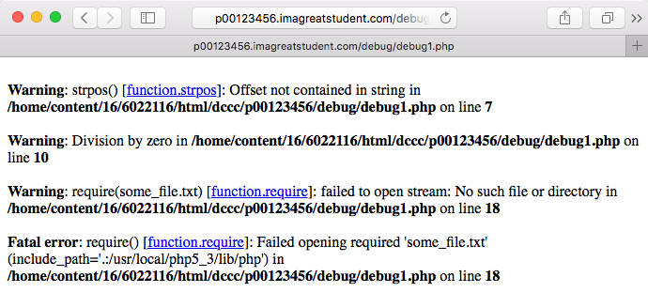
How to Read Error Messages
Open debug1.php in editor
Upload and test on your server

Slide 11
2 Levels of Error Messages
Warnings
Don’t stop the execution of the script
Scripts should not have warnings when correctly executed.
Fatal Errors
Stop the execution of a script.

Slide 12
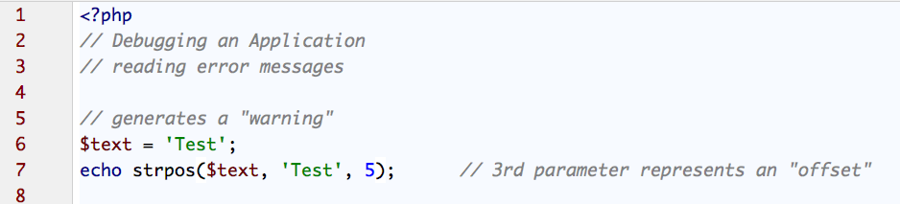
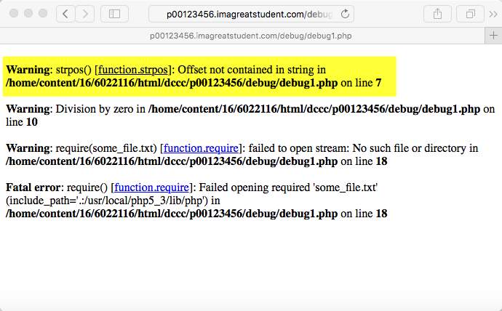
strpos() Warning
Logic error causing a warning.
This code is looking to find something starting at string position 5, but it only has 4 letters.

Slide 13

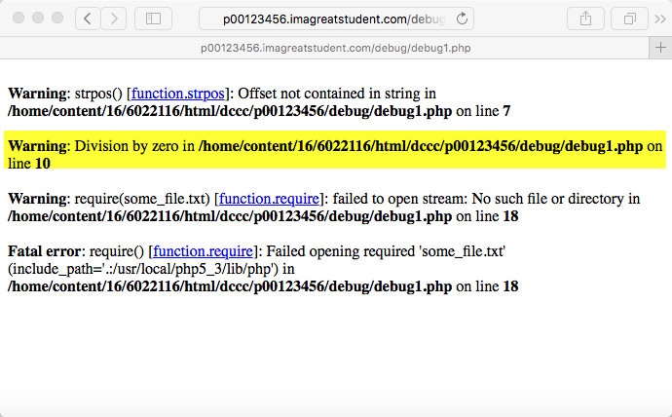
Division by zero
Dividing by zero is not allowed

Slide 14

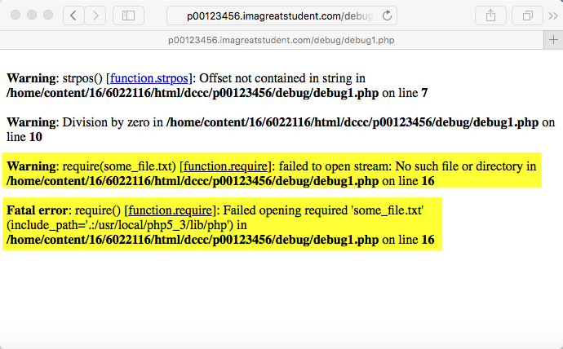
require() Warning
Using require() will generate a warning and a fatal error.
include() would only generate a warning.

Slide 15
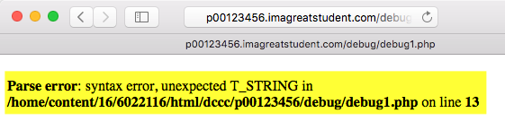
Uncomment the $error line
Note the error indication in the IDE.
Upload and test on the server.

Slide 16
unexpected T_STRING
Usually the case when you have an improperly quoted string.
Very common, and easy to make this error.

Slide 17
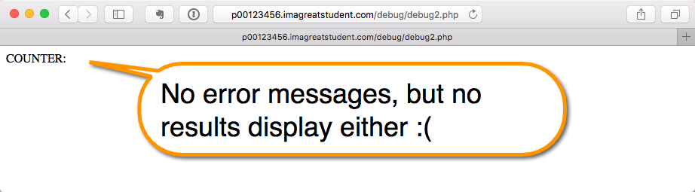
How to Display More Error Messages
Open debug2.php in editor
Upload and test on your server

Slide 18
Displaying PHP Errors
PHP provides useful and descriptive error messages when things go wrong.
Unfortunately, PHP doesn’t show these errors when running using its default configuration.
This policy makes sense for live servers, where you don’t want the end users seeing PHP-specific error messages.
To be able to see PHP’s errors, you must turn on the display_ errors directive, either in an individual script or for the PHP configuration as a whole.
We will do it on a script-by-script basis.

Slide 19
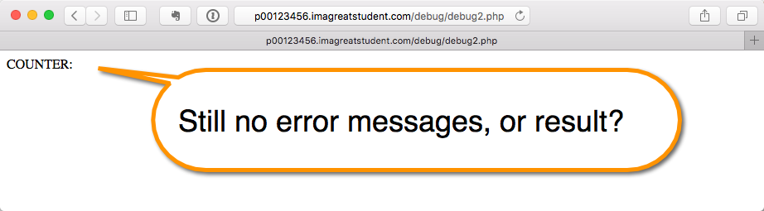
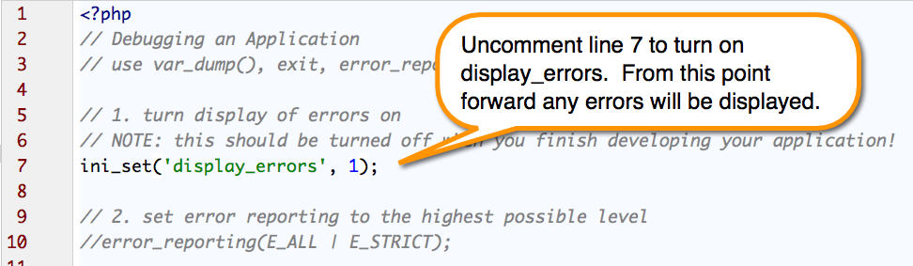
Turn on display_errors
From within a script, use the ini_set('display_errors', 1) function.
Run and test it on the server again.

Slide 20
Changing the Error Setting
Once you have PHP set to display the errors that occur, you might want to adjust the level of error reporting.
Your PHP installation as a whole, or individual scripts, can be set to report or ignore different types of errors.

Slide 21
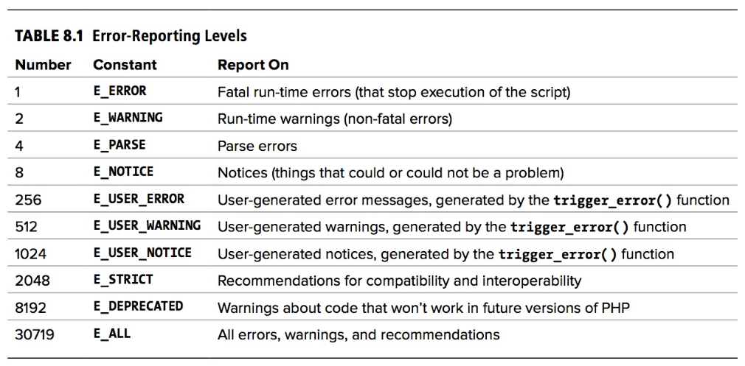
Source: Visual QuickPro Guide: PHP and MySQL for Dynamic Web Sites, Fourth Edition, Larry Ullman

Slide 22
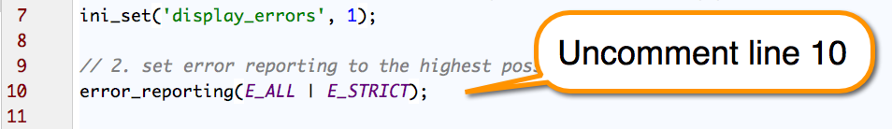
Set Error Reporting Level
E_ALL – all errors
| is a logical “or”
E_STRICT – combined with E_ALL gives all possible warning and error combinations.
Save, upload and test on your server.

Slide 23
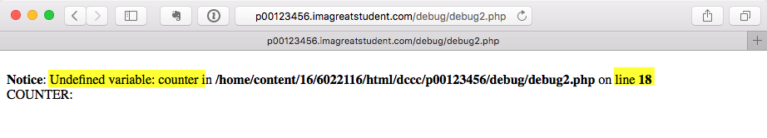
Success?
Finally a message for why it isn’t working.

Slide 24
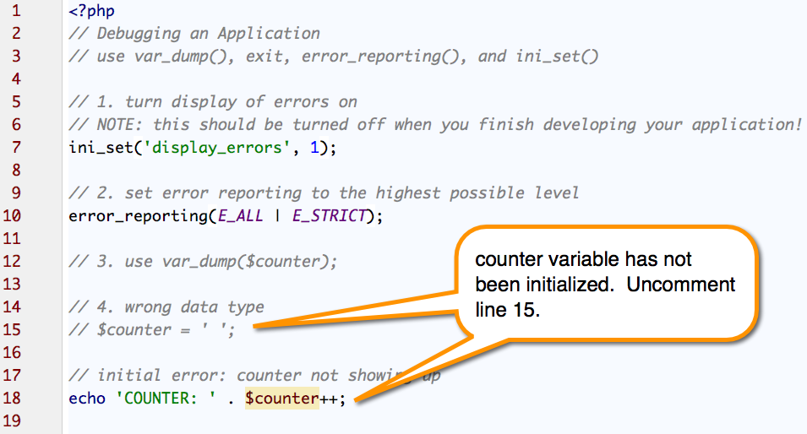

Slide 25
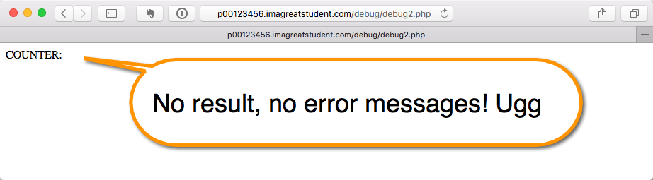
Save, upload, test.

Slide 26
var_dump() function
Print out values without the need for loops.
Used to display structured information (type and value) about one or more variables.
Syntax: var_dump($variable1, $variable2);

Slide 27
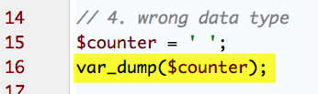
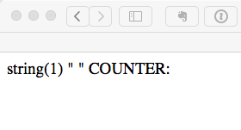
Add var_dump, test
This shows that the counter is a string.
Can’t add a number to a string, we need a number data type.

Slide 28
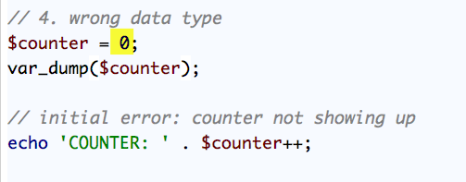
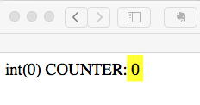
Change the Data Type
Save, upload, test.
Success!!

Slide 29
Remember…
To turn off/comment out the PHP debugging tools:
ini_set()
error_reporting()
var_dump()
You don’t want those to show in a final production version.

Slide 30
Trace
Use print and echo
You can narrow down where something started/stopped working by printing out a quick message.
Display the value of a variable. Sometimes it’s not what you expect.

Slide 31
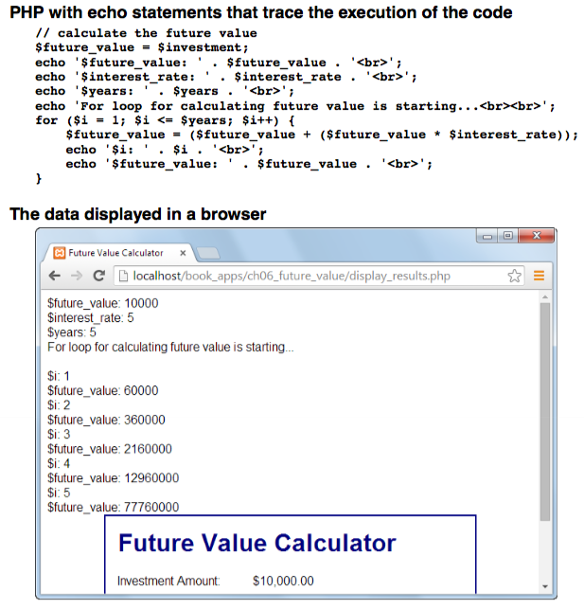

Slide 32
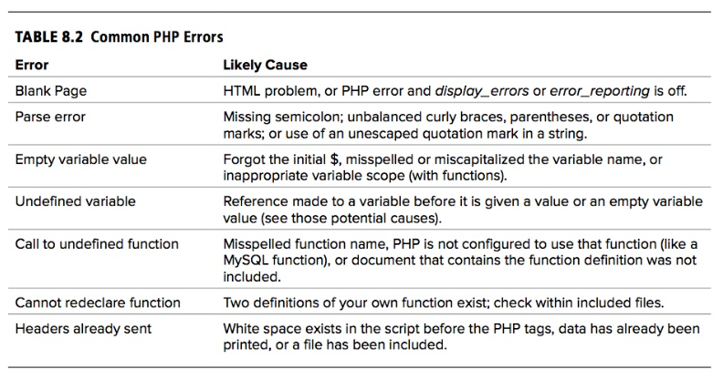
Source: Visual QuickPro Guide: PHP and MySQL for Dynamic Web Sites, Fourth Edition, Larry Ullman

Slide 33
Common SQL Errors
Unbalanced use of quotation marks or parentheses
Unescaped apostrophes in column values
Misspelling a column name, table name, or function
Ambiguously referring to a column in a join
Placing a query’s clauses (WHERE, GROUP BY, ORDER BY, LIMIT) in the wrong order
Inability to access the database

Slide 34
Debug SQL Queries
Use an online syntax checker
No changes to your database, just a syntax checker
https://www.piliapp.com/mysql-syntax-check/
Run the SQL query in the MySQL client (i.e. phpMyAdmin)
Will change your database if query is designed for modifying/updating

Slide 35
Debug Access Problems
Access-denied errors are most common.
Password problems
Access denied for user: ‘user@localhost’ (Using password: YES) frequently indicates that the password is wrong or mistyped.
The error message Can’t connect to… (error number 2002) indicates that MySQL either is not running or is not running on the socket or TCP/IP port tried by the client.

Slide 36
Debugging HTML
A good HTML editor can help find errors with color coding changes.
Some editors flag lines with errors.
Use a validation tool (http://validator.w3.org)
If your html is being generated through PHP code, try doing a “view source” after viewing the page output and running it through a validator.

Slide 37
Wrap Up
Distinguish between testing and debugging.
Testing - To find all errors
Debugging – To fix all errors

Slide 38
Wrap Up
Distinguish between syntax, runtime and logic errors.
Syntax errors
Easiest to find
IDE helps detect
Runtime errors
Appear when running the application
Don’t violate syntax rules but cause interpreter errors.
Logic errors
Hardest to detect

Slide 39
Wrap Up
How do you debug a PHP application without special tools?
Reading and decoding error messages.

Slide 40
Wrap Up
Are there PHP commands which help debugging?
ini_set('display_errors', 1);
error_reporting();
var_dump();

